Slide 1
Cooperative Learning in a Business Class
By Tina Murphy tmurphy@fulton58.org

Slide 2
Cooperative learning
Teacher’s Academy
Cooperative learning vs. Group Work
  Group Work: One person might do everything
  Cooperative learning: Everyone is involved

Slide 3
Mints
Help with sleepiness
Tips
  Buy them at the Dollar Store
  Last about a week when we were on block
  Offer as bonus
  Monitor how many students take

Slide 4
Find Someone Who
Activity:
  Have students put an answer in a box of someone else's paper.
  One answer per paper
Prep:
  Make a Bingo Card with questions in each box
Tips:
  Great as a review
  All students can do it. Absent student doesn't have to answer a question the first round. They can write the answer that was written on their paper
  Very Easy, but don't use too much. Kids get bored of it

Slide 5
Quiz, Quiz, Trade Activity
You need to model process
Give each student a card
Have the students put the Defintion/Answer side towards them (Say line or blank side)
Find a partner
Students quiz each other
Trade cards
Give each other knuckles

Slide 6
Quiz, Quiz, Trade Activity
Put hand in the air and find a new parter
Give new partner a Hi-Five
Repeat Process
You as teacher just sit back and relax!!!

Slide 7
Quiz, Quiz, Trade Prep
Make a Powerpoint
Question/Word on one slide and put Definition/Answer on another slide
Print 6 slides/page
Glue all Q/W's on the same side of index card (lined or blank)
Get Laminated

Slide 8
Quiz, Quiz Trade Tips
Need one set for the class
Need enough cards for students
If not enough Q/W's, repeat the some important ones
Be in a big area to spread out
Buy sandwich bags and mark the bag with the topic of cards

Slide 9
Plates
Activity:
  Have students answer questions on the plates
  Have students wait until you ask them to show their plates
Tips:
  Buy colored plastic plates
  Buy wash clothes
  Need lots of dry erase markers (keep in a shoe box)
Other Uses:
  Partner up with someone of same/different color
  Compare/Contrast: need 3 plates/pair

Slide 10
Questions
What is MU’s mascot?
  Truman the Tiger
What are the NFL team located in Missouri?
  St. Louis Rams and Kansas City Chiefs
What are the names of the NASCAR drivers from Missouri?
  Carl Edwards and Jamie McMurray

Slide 11
Memory Game Activity and Tips
Activity:
  Exactly like normal game
Tips:
  Have group of no more than 4.

Slide 12
Memory Game Prep
Make a PowerPoint Presentation
Put Term on one slide
Put Defintion on another slide
Make a solid colored background
Print 6 on a page
Print on card stock
Print each set of cards with a different colored background

Slide 13
Post-it Activity
Give each student a post-it note
Have them tear the Post-it into 4 pieces
  Each piece needs sticky stuff on it
Have students write 1 number on each post-it piece
  Tell them the range
  Depends on how many questions you have
  Make sure to say you can include #1 and the last #
  If you have 12 questions, say you may pick between 1 and 12 including the #1 and 12.

Slide 14
Post-it Prep
1 | Question
2 | Question
Make a table in Word with the amount of questions you want to review
Print and glue index card or print on construction paper
Laminate

Slide 15
Post-it Activity
Have students put the post-it's on the edge of a book, planner, or plate with the numbers facing them
Give each student a card
Find a partner
Partner A holds up their book and Partner B picks a post-it off of it.
Partner B reads the number out loud and puts the post-it on their book
Partner A read the corresponding question to the number

Slide 16
Post-it Activity
Partner B answer the question out loud
Repeat process for Partner A
Students give knuckles
Put hand in air and find a new partner
Give each other a Hi-5

Slide 17
Post-it Tips
If information is new (before the activity)
  Have students write out the answers to the questions
  Turn to a partner and share the answers
Need a big area to spread out
Use sandwich bags to organize the information

Slide 18
Snowball Fight
Process:
  Write question/problem on a piece of paper
  Make a snowball
  Have a snowball fight for 1 min
  Answer the questions
Tips:
  Do this in a hallway
    You will lose some with bags and desks
  Remind the students to be nice

Slide 19
Gallery Walk
A great way to show off work
Have students place their work/information on the wall for others to see
Can be used with analyzing different options

Slide 20
Rock-Paper-Scissor Process
Have students get a partner
Tell the partners to establish R-P-S Rules
  Some kids do R-P-S and show move
  Others do R-P-S Shoot and show move
Tell them who has to answer the question
  Winner or Loser
Read question
Have students think about it
Then you say “go” and they play R-P-S

Slide 21
Questions
Who is the President of the US?
  Obama
Who is the Governor of Missouri?
  Jay Nixon
Who is the President of MBEA?
  Gina McLachlan

Slide 24
Rock-Paper-Scissor Tips
Great if you want a quick review
Do write key words on the board
  Kids will get very involved in playing
  Sometimes I have them play R-P-S, then pick W or L, and then read a question
This can be done after one of the other activities

Slide 25
Polleverywhere.com
An Internet site that allows you to ask/ “poll” your students over your content
They text in their responses or use the internet on the computer
It is FREE to use
Can upgrade

Slide 26
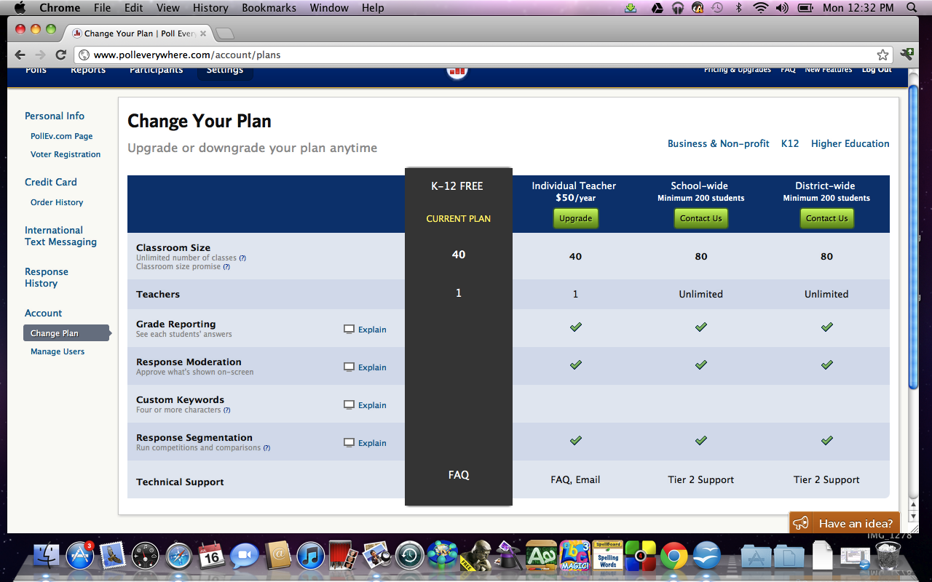

Slide 27
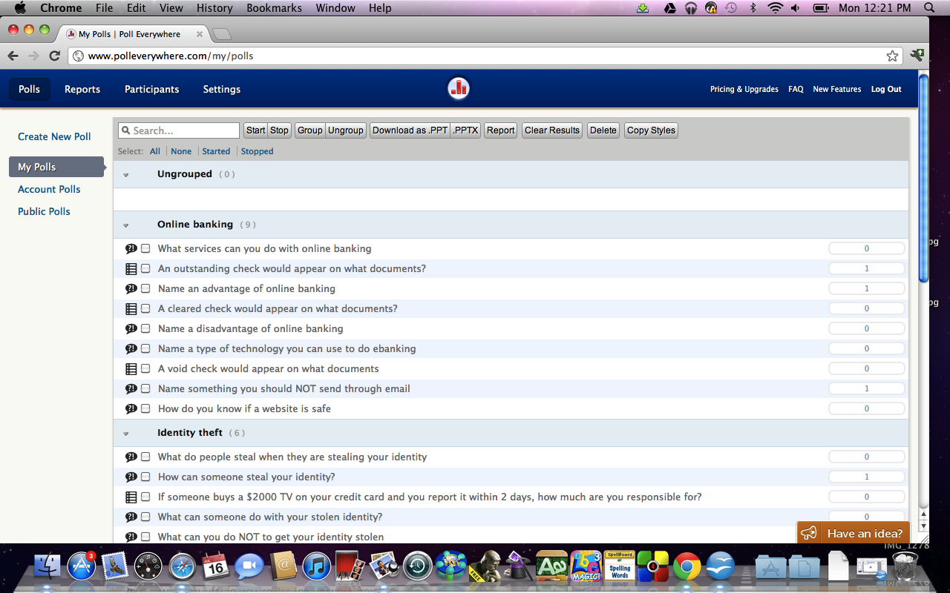
Polleverywhere.com

Slide 28
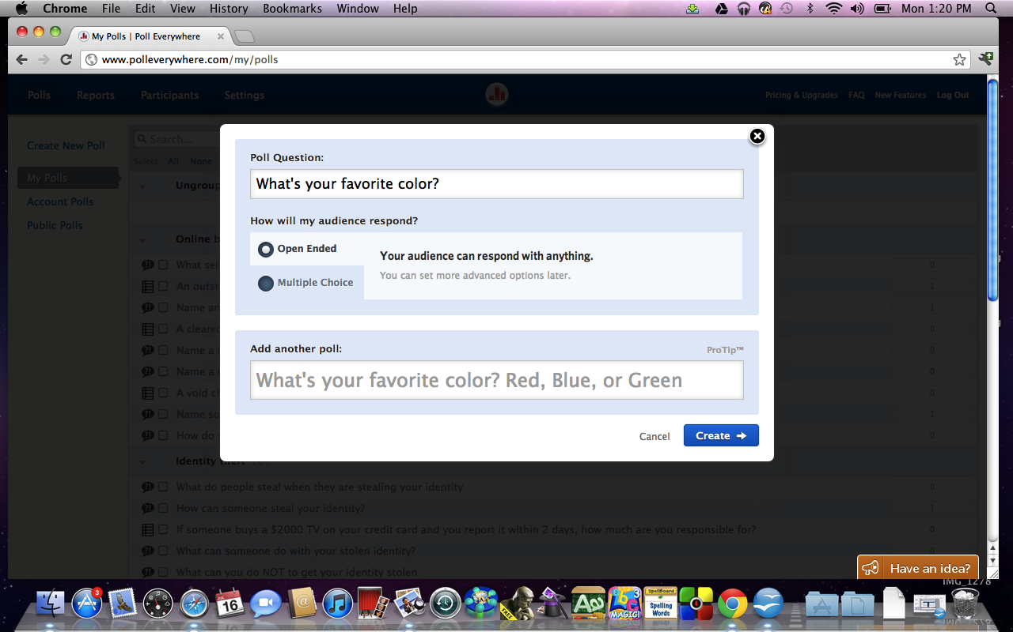
Question Options

Slide 29
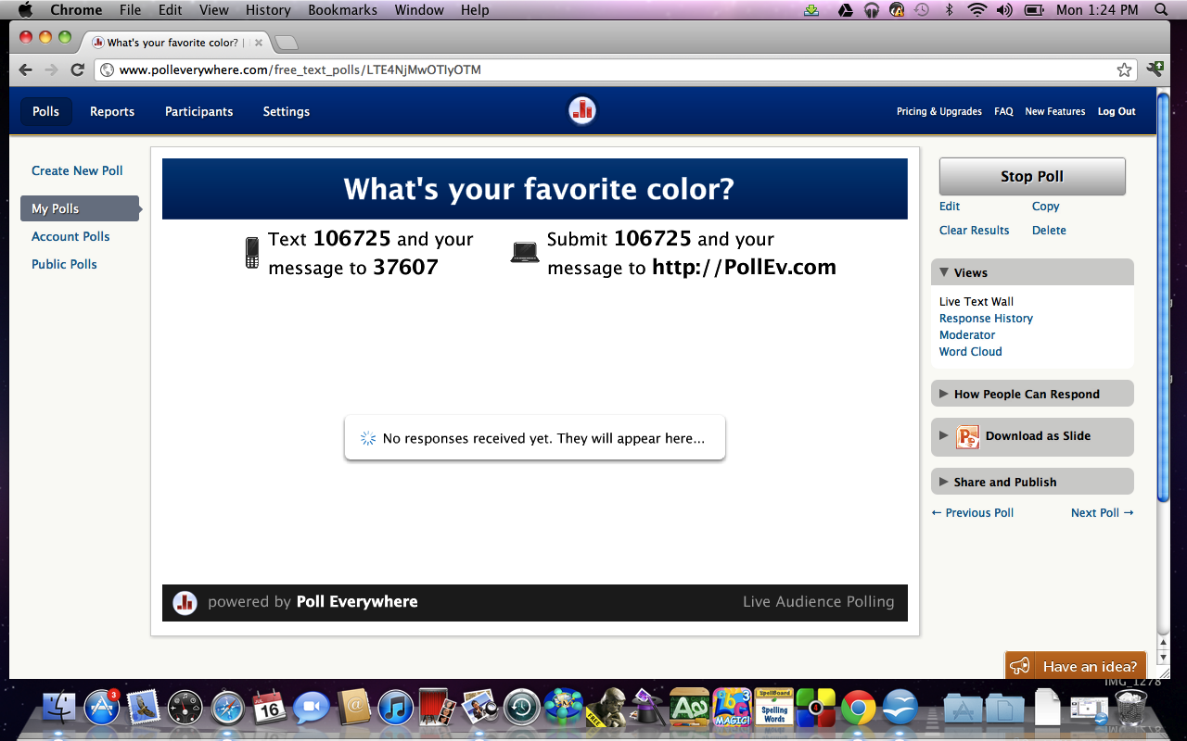
Open Ended Questions

Slide 30
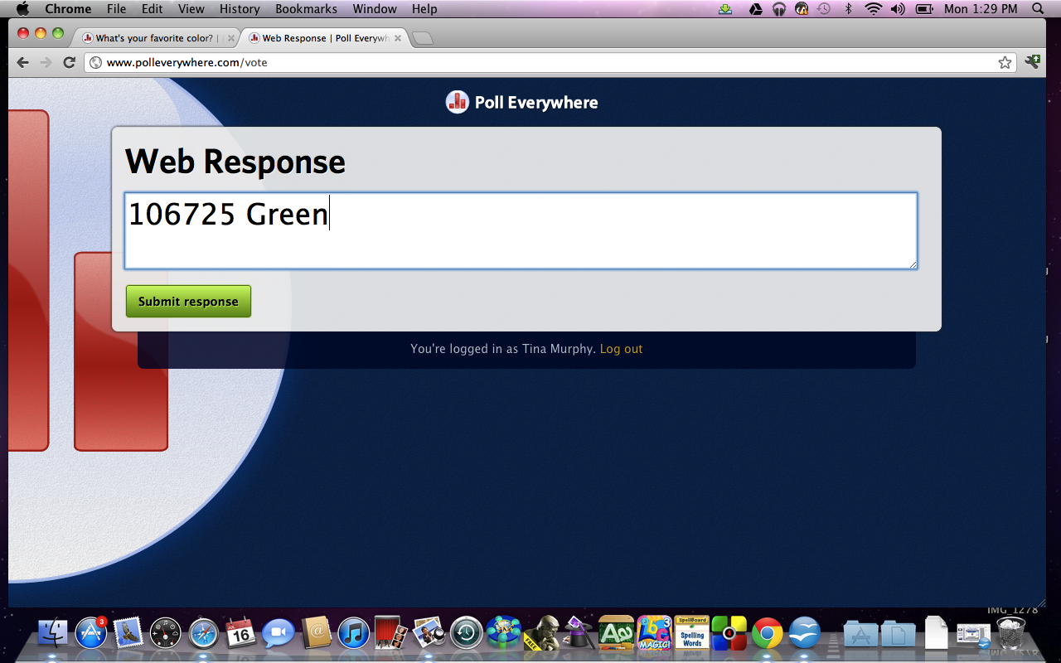
Type in Answers

Slide 31
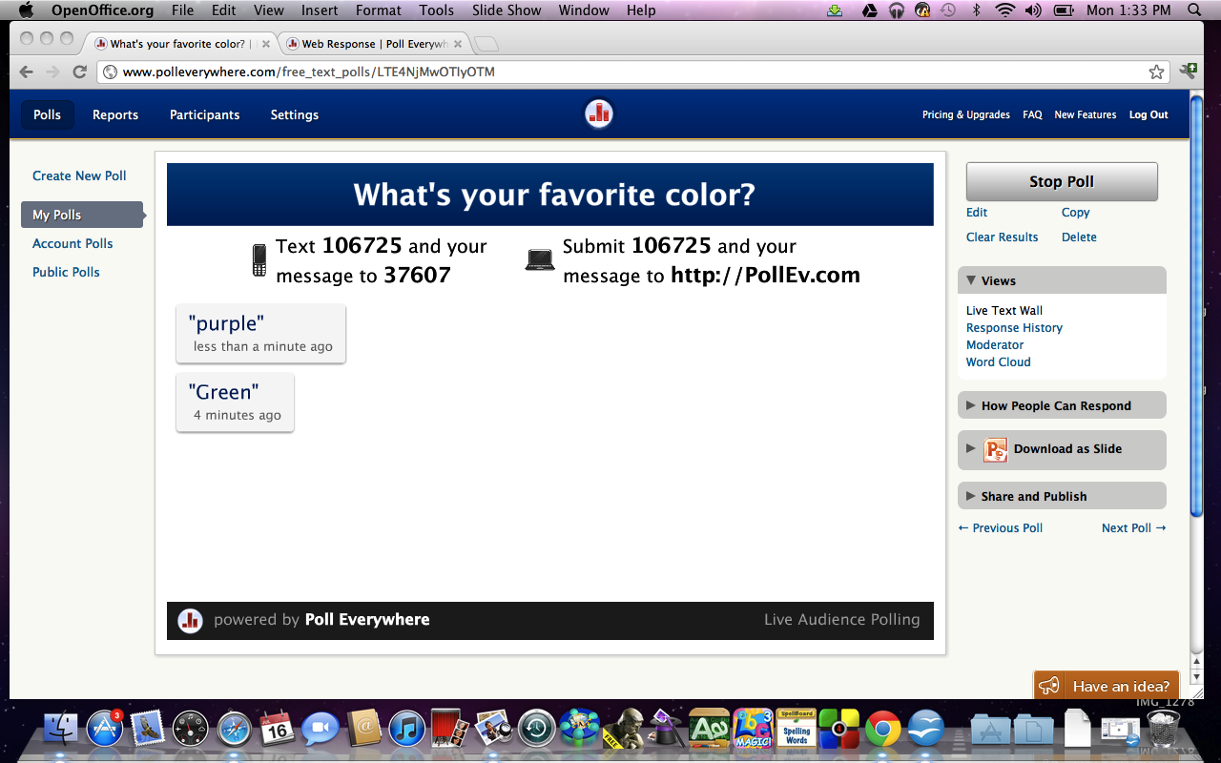
Responses

Slide 32
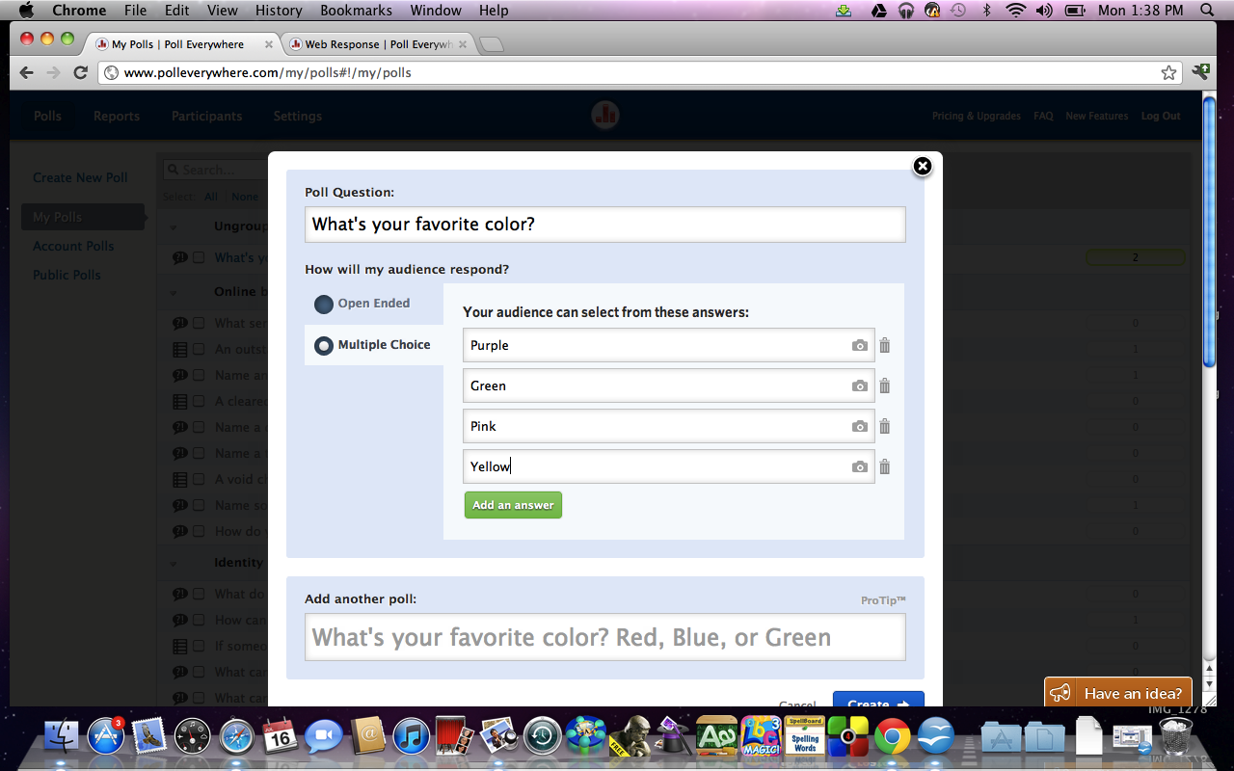
Multiple Choice Questions

Slide 33
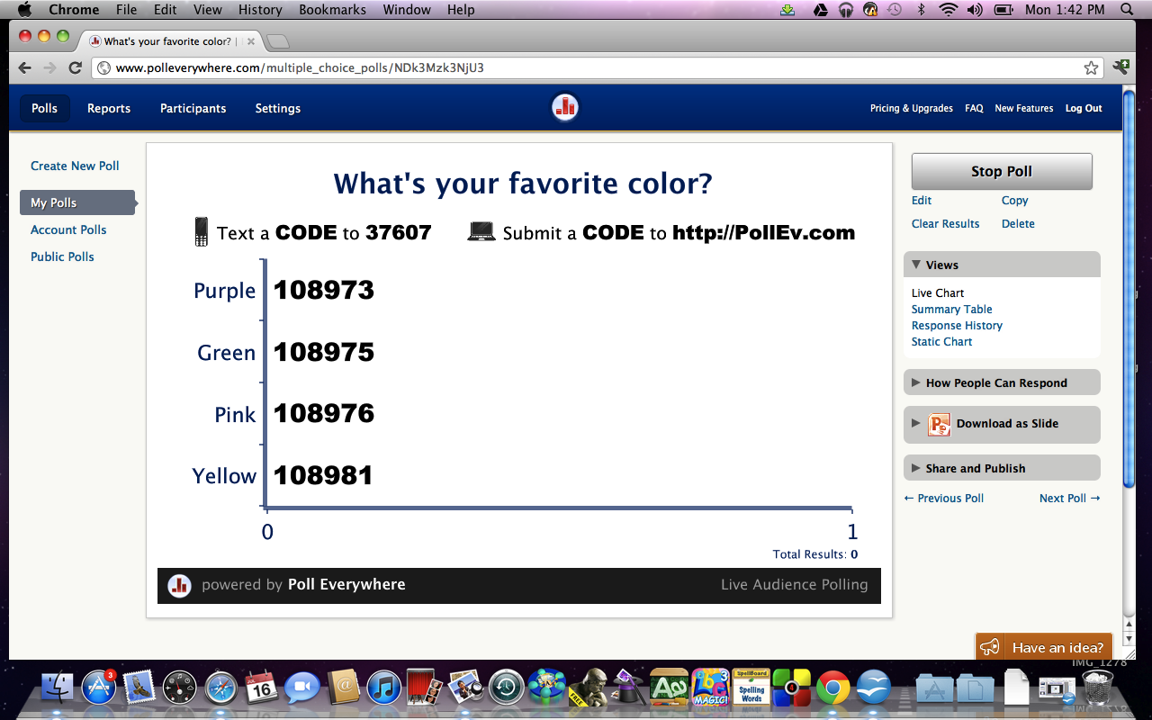
Question

Slide 34

Answers

Slide 35
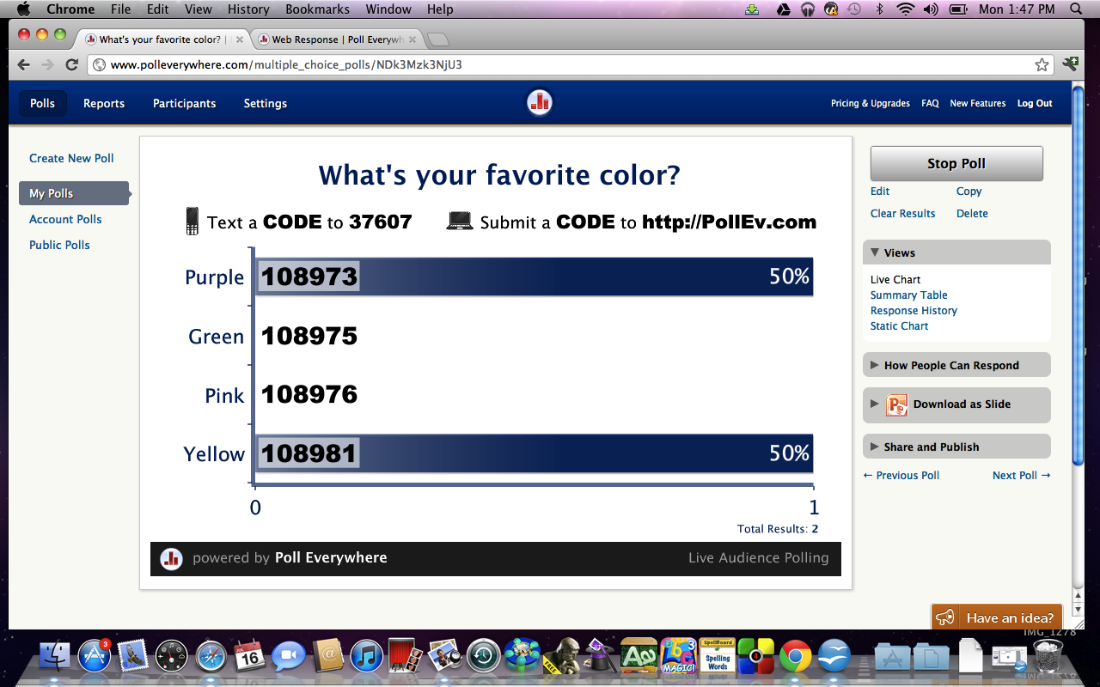
Responses

Slide 36
Pollev.com
On MC, I tell them when to submit their answers.
  This way everyone has time to think of an answer
  Unfortunately, it doesn't always work

Slide 37
Any Questions

