Slide 1
“Disruptive Behavior Solutions”
Chris Spurlock
Summer, 2012
cspurlock@sikeston.k12.mo.us

Slide 3
“The Most Powerful Solutions to Eliminating Chronic Disruptive Behaviors”
Kevin Dill, Ed. S., S.N.T Ed. Consulting
showntell411@yahoo.com
www.showandtellconsulting.com

Slide 4
Three Types of Students

Slide 5
“Always”

Slide 6
These are the kids who do the right thing--- ALWAYS!!!

Slide 7
“Sometimes”

Slide 8
These are the kids who do the right thing--- SOMETIMES???

Slide 9
“Never” kids are NEVER absent!!!!
Notes:
Close your eyes and think of that NEVER student in your mind.

Slide 10
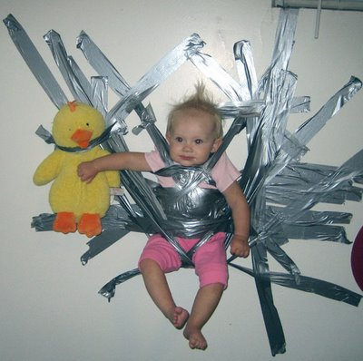

Slide 11
Popular Treatments That Don’t Work
Treatment/Intervention Effect Size
Meeting with student .00
Punitive discipline -.13 to +.06
Alternative placement -.10 to +.04
Special education -.03
POOR OUTCOMES FOR STUDENTS

Slide 12
Not So Popular Strategies That DO Work
Strategies Effect Size
Positive Behavioral Supports +.90
Social Skills Training +.68
Group-based contingency +.81
Token economy +.60
Social emotional learning +1.00
Formative Evaluation + Graphing + +1.20
Reinforcement
Mentor-based program +1.00
Kavale (2005); Marquis et al. (2000); Cook et al. (in press);
Blueprints for Promising Treatments (1999); Reschly (2004)

Slide 13
Punishment does not change behaviors!
If it did, there would be no need
for prisons.
Story of Coach and Basketball Player-
No Pass, No Play
Notes:
Can’t use Band-aid approach---doesn’t stay on forever!

Slide 14
The Key to Behavior Mgt. is NOT only being consistent…..
It is Being CONFIDENT!
Notes:
Kids read right through you!

Slide 15
Kids Don’t Crave Discipline…
They Crave Boundaries!

Slide 16
A Prevention System The Most Powerful Solution!
Prevention is one of the most powerful tools in minimizing chronic disruptive behavior and increasing Academic Engaged Time (AET).
Increased AET = Increased Performance

Slide 17
Positive Behavioral Interventions Support
aka PBIS or PBS
Definition:
A systems change process for an entire school or district. The underlying theme is teaching behavioral expectations in the same manner as any core curriculum subject.

Slide 18
School Wide Positive Approach
Sample of General School Wide Expectations
I Can Be Respectful
I Can Be Responsible
I Can Be Safe
I Can Build Relationships
I Can Be Prepared

Slide 19
School Wide Positive Approach
Sample of School Wide Consequences
I Can Earn Privileges
I Can Lose Privileges
I Can Participate in Extra-Curricular
I Can Attend Assemblies & PBIS Celebrations

Slide 20
Expectations Everywhere
Restroom
Hallway
Bus
Cafeteria
Gymnasium
Classroom

Slide 21
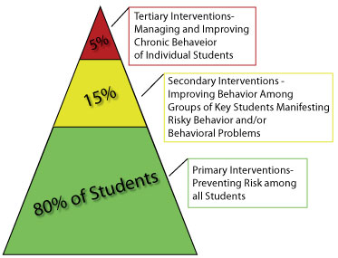
Positive Behavioral Interventions Support (PBIS)

Slide 22
PB IS – Tier One Basics
Strategies are for all students, in every classroom, and throughout the school campus. Universal screening identifies who is a “non responder.”

Slide 23
Pro-Active Strategies
Unconditional Positive Regard
Students are Human Beings, not Human Doings
“Three walks per week” – Mr. Brunkhorst
5:1 Ratio of Positive to Negative Comments
More gestures and comments to corrective statements are given for each student
Human Needs are Fostered
Teacher designed interactions and activities
Fun (Learning can be exciting!)
Freedom (wide variety of choices are available)
Empowerment (Privileges can be earned!)
Belonging (Membership in a group is fostered!)
Physical (food, water, etc…..)
Notes:
Connections should not be school-related….
“Bulldog Tickets” - Pass out when students exhibit positive behavior

Slide 24
Pro-Active Strategies
Informational Feedback –vs.- Judgmental Feedback
“You have completed 1; you have 8 left to do.”
“We have been doing this all year; where have you been?”
Teach Compliance – Don’t Demand Submission
Individual Reinforcement
Is available, with choices given within whole group designs.
On-going Expectation & Procedure Teaching
Reinforcement when adherence occurs. (After breaks, also!)
Classroom procedures are taught systematically.
Notes:
Fast Pass for Lunch

Slide 25
Pro-Active Strategies
Direct Instruction
Emphasizes high student engagement with multiple opportunities to respond to partners, groups and teachers. Hands on learning activities predominate, rather than the ineffective lecture-worksheet style of instruction.
Differentiated Instruction & Accommodations
Assure content is at Instructional Level, NOT independent level or frustration level.
Self Governance Meetings
Weekly/Monthly classroom meetings
Problems
Solutions
Vote
Implement
Notes:
Fast Pass for Lunch

Slide 26
Remember this?

Slide 27
Helpful Websites……
Harry Wong Publications
Going Beyond
www.effectiveteaching.com
Teachers Net Gazette
www.teachers.net/wong

Slide 28
Questions ??????

